Slide 1
CoMP 1011 - Final Presentation
Nov, 18th 2017
Wei-Ting Lin
Soheil Hajimohammadi
Notes:
Good morning everyone! My name is Wei-Ting and I’m Soheil.
Together, we’re part of a small UI development team in the heart of Vancouver, presenting to you our newest app idea - Cozy!

Slide 2
Co.zy
Co.zy is a mobile app for office workers that is designed to eliminate employee discomfort and increase work productivity by offering a simple and interactive UI that is used to adjust workplace temperature, lighting and humidity.
Notes:
Co.zy is a mobile app for office workers that is designed to eliminate employee discomfort and increase work productivity by offering a simple and interactive UI that is used to adjust workplace temperature, lighting and humidity.

Slide 3
Co.zy
Co.zy gives employees the ability to monitor current indoor air quality in their thermal zone in the building
Co.zy interactively changes temperature, lighting, and air velocity to match their comfort levels
Managers will be able to see clear, detailed data analysis of these changes
The building’s HVAC control system will process these data points in a mechanical systems feedback loop
Notes:
Co.zy gives employees the ability to monitor current indoor air quality in their thermal zone in the building
Co.zy interactively changes temperature, lighting, and air velocity to match their comfort levels
Managers will be able to see clear, detailed data analysis of these changes
The building’s HVAC control system will process these data points in a mechanical systems feedback loop

Slide 4
Co.zy
Employees will commit 44% less errors and will be more productive when the temperature is set at a comfortable level (which is approx. 77 degrees) and indoor air quality is within residents comfort levels.
The increase in performance will financially benefit employers by 10% per hour, per employee.
These statistics were gathered from the Cornell University research study by Professor Alan Hedge (June 2004).
Link to study: http://ergo.human.cornell.edu/Conferences/EECE_IEQ%20and%20Productivity_ABBR.pdf
Notes:
Employees will commit 44% less errors and will be more productive when the temperature is set at a comfortable level (which is approx. 77 degrees) and indoor air quality is within residents comfort levels.
The increase in performance will financially benefit employers by 10% per hour, per employee.

Slide 5
FEATURES
Co.zy can sync with employee work hours to adjust temperature levels back to the default levels to save on costs when the employee ends their work day.
1
Co.zy offers Employees to view current temperature and air velocity set points and set their own default levels in their workplace. This will reduce the amount of time to adjust comfort levels at the beginning of the workday.
4
5
Co.zy can predict the comfort of new employees in various office locations by comparing comfort levels with the demographic information of existing employees.
2
Co.zy offers a simplified user interface that gives ease of use for users of all skill levels.
3
Co.zy offers support in several languages: English, Chinese, Hindi, Arabic, Spanish, French, Japanese, Korean, Italian, Russian, and German. Each employee can choose their language of preference when they run the app.
6
Co.zy is designed to have a minimal time impact on employees while providing a large energy savings to employers.
Notes:
Co.zy
offers Employees to view current temperature and air velocity set points and set their own default levels in their workplace. This will reduce the amount of time to adjust comfort levels at the beginning of the workday.
offers a simplified user interface that gives ease of use for users of all skill levels.
offers support in several languages such as English, Chinese, and French. Each employee can choose their language of preference when they run the app.
can sync with employee work hours to adjust temperature levels back to the default levels to save on costs when the employee ends their work day.
can predict the comfort of new employees in various office locations by comparing comfort levels with the demographic information of existing employees.
is designed to have a minimal time impact on employees while providing a large energy savings to employers.

Slide 6
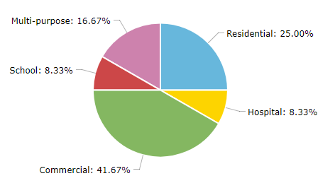
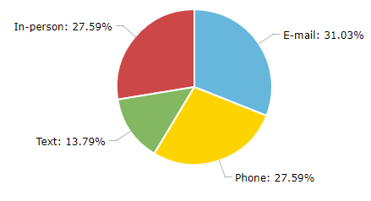
INTERVIEWS/SURVEYS
Building Type
Communications type
Notes:
Through our interviews and surveys, we found that a majority of users worked in a commercial building and communicate often using their phones.

Slide 7
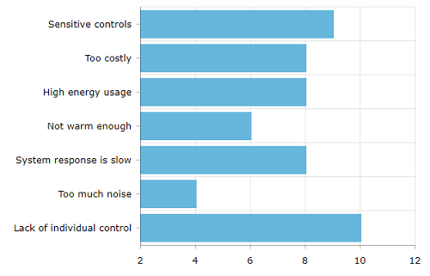
INTERVIEWS/SURVEYS
HVAC PROBLEMS
Notes:
However, we also found that there was a long list of problems concerning their current HVAC systems installed in their building. Problems that were brought up were:
The system has sensitive controls (where it can be too hot or too cold far too easily)
The system is too costly to maintain and replace broken parts
The system has high energy usage, which is not environmentally friendly
The system is not strong enough to provide warmth during colder months of the year
The system is slow and inefficient at responding to thermostat changes
The system makes too much noise that is distracting for building occupants
And there is a lack of individual control options for one or more aspects of the system

Slide 8
DESIGNING THE APP
Logo to seem friendly and easy to recognize
Clean layout (flat design icons, easy to read text, usage of whitespace)
Professional colour scheme that is business friendly
Aiming for easy to use UI for all skill levels so that it is accessible for anyone
Notes:
We wanted to design an app that:
has a friendly and easy to recognize logo
incorporates flat design, legible text, and whitespace for a cleaner layout
uses a professional colour scheme that is business friendly
And aims to have an easy-to-use user interface for all skill levels to use, so that it’s accessible for anyone

Slide 9
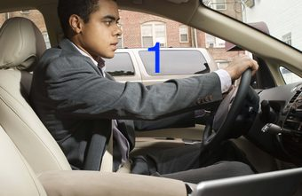
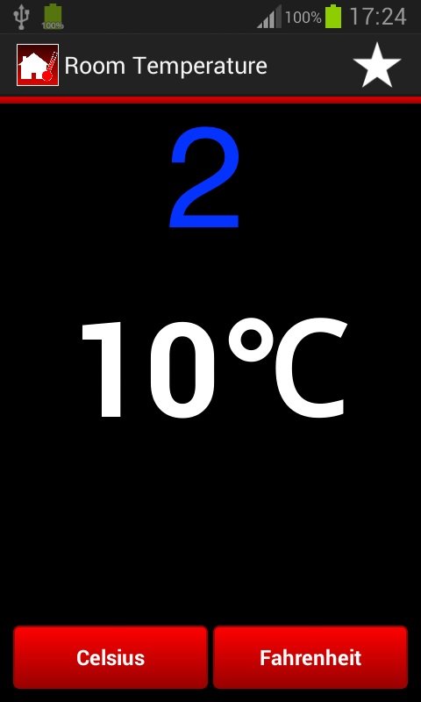
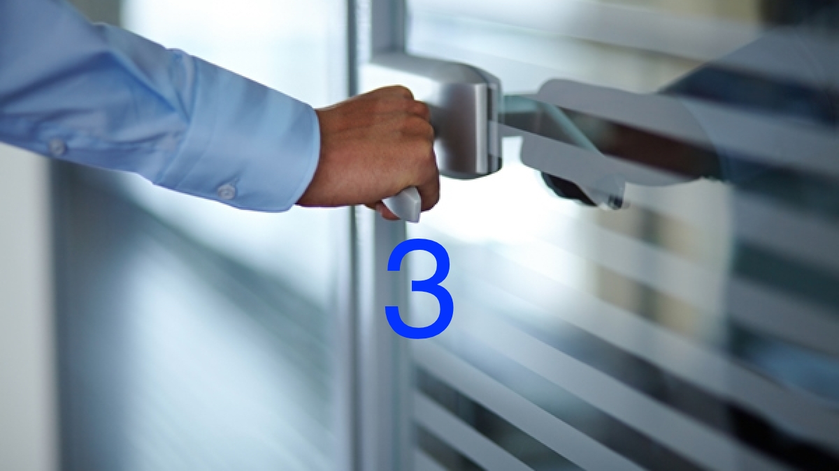
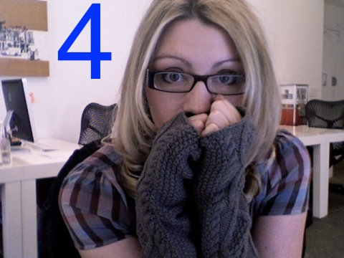
IDEA
Users can set a temperature at their workspace before coming into the office to save time and feel more comfortable upon arrival
Users can select the room they have HVAC access to in order to adjust the temperatures of the room that they are currently in.
Meeting and shared common rooms are set to trending average employee comfort temperatures taken from app data (and can be changed manually by management).
Notes:
Users can set a temperature at their workspace before coming into the office to save time and feel more comfortable upon arrival
Users can adjust temperatures ranging from 15 C to 25 C.
Users can select the room they have HVAC access to in order to adjust the temperatures of the room that they are currently in.
Meeting and shared common rooms are set to trending average employee comfort temperatures taken from app data (and can be changed manually by management).

Slide 10
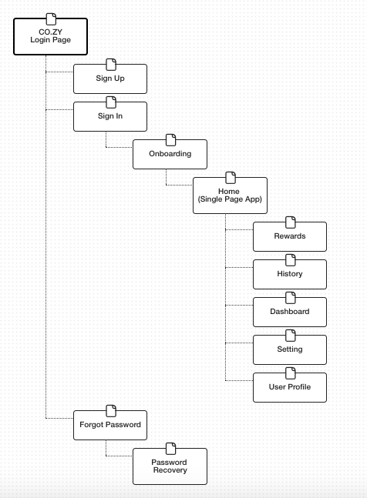
SITE MAP

Slide 11
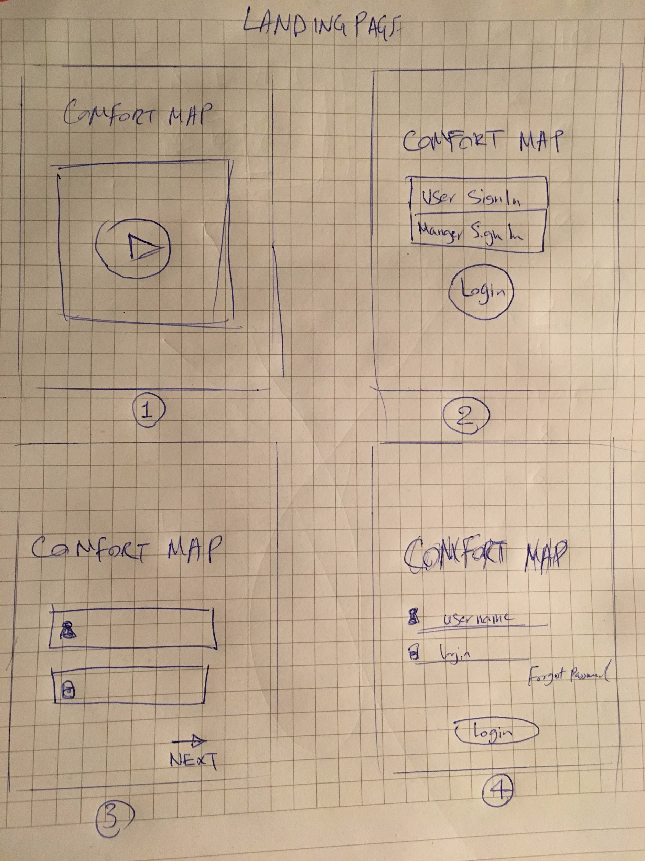
WIREFRAMES
Notes:
These are our wireframe iterations for our landing page.
We first wanted to make a video tutorial of our app, but we realized that most people won’t want to sit through a 5min video just to use an app.
We then realized that there wasn’t a place for users to reset their password, in case they forgot it. There also wasn’t a page just for Signing Up, that the user can access through the Login page, so we added those links in to ensure that the user can have access to all of these components in 1 screen.

Slide 12
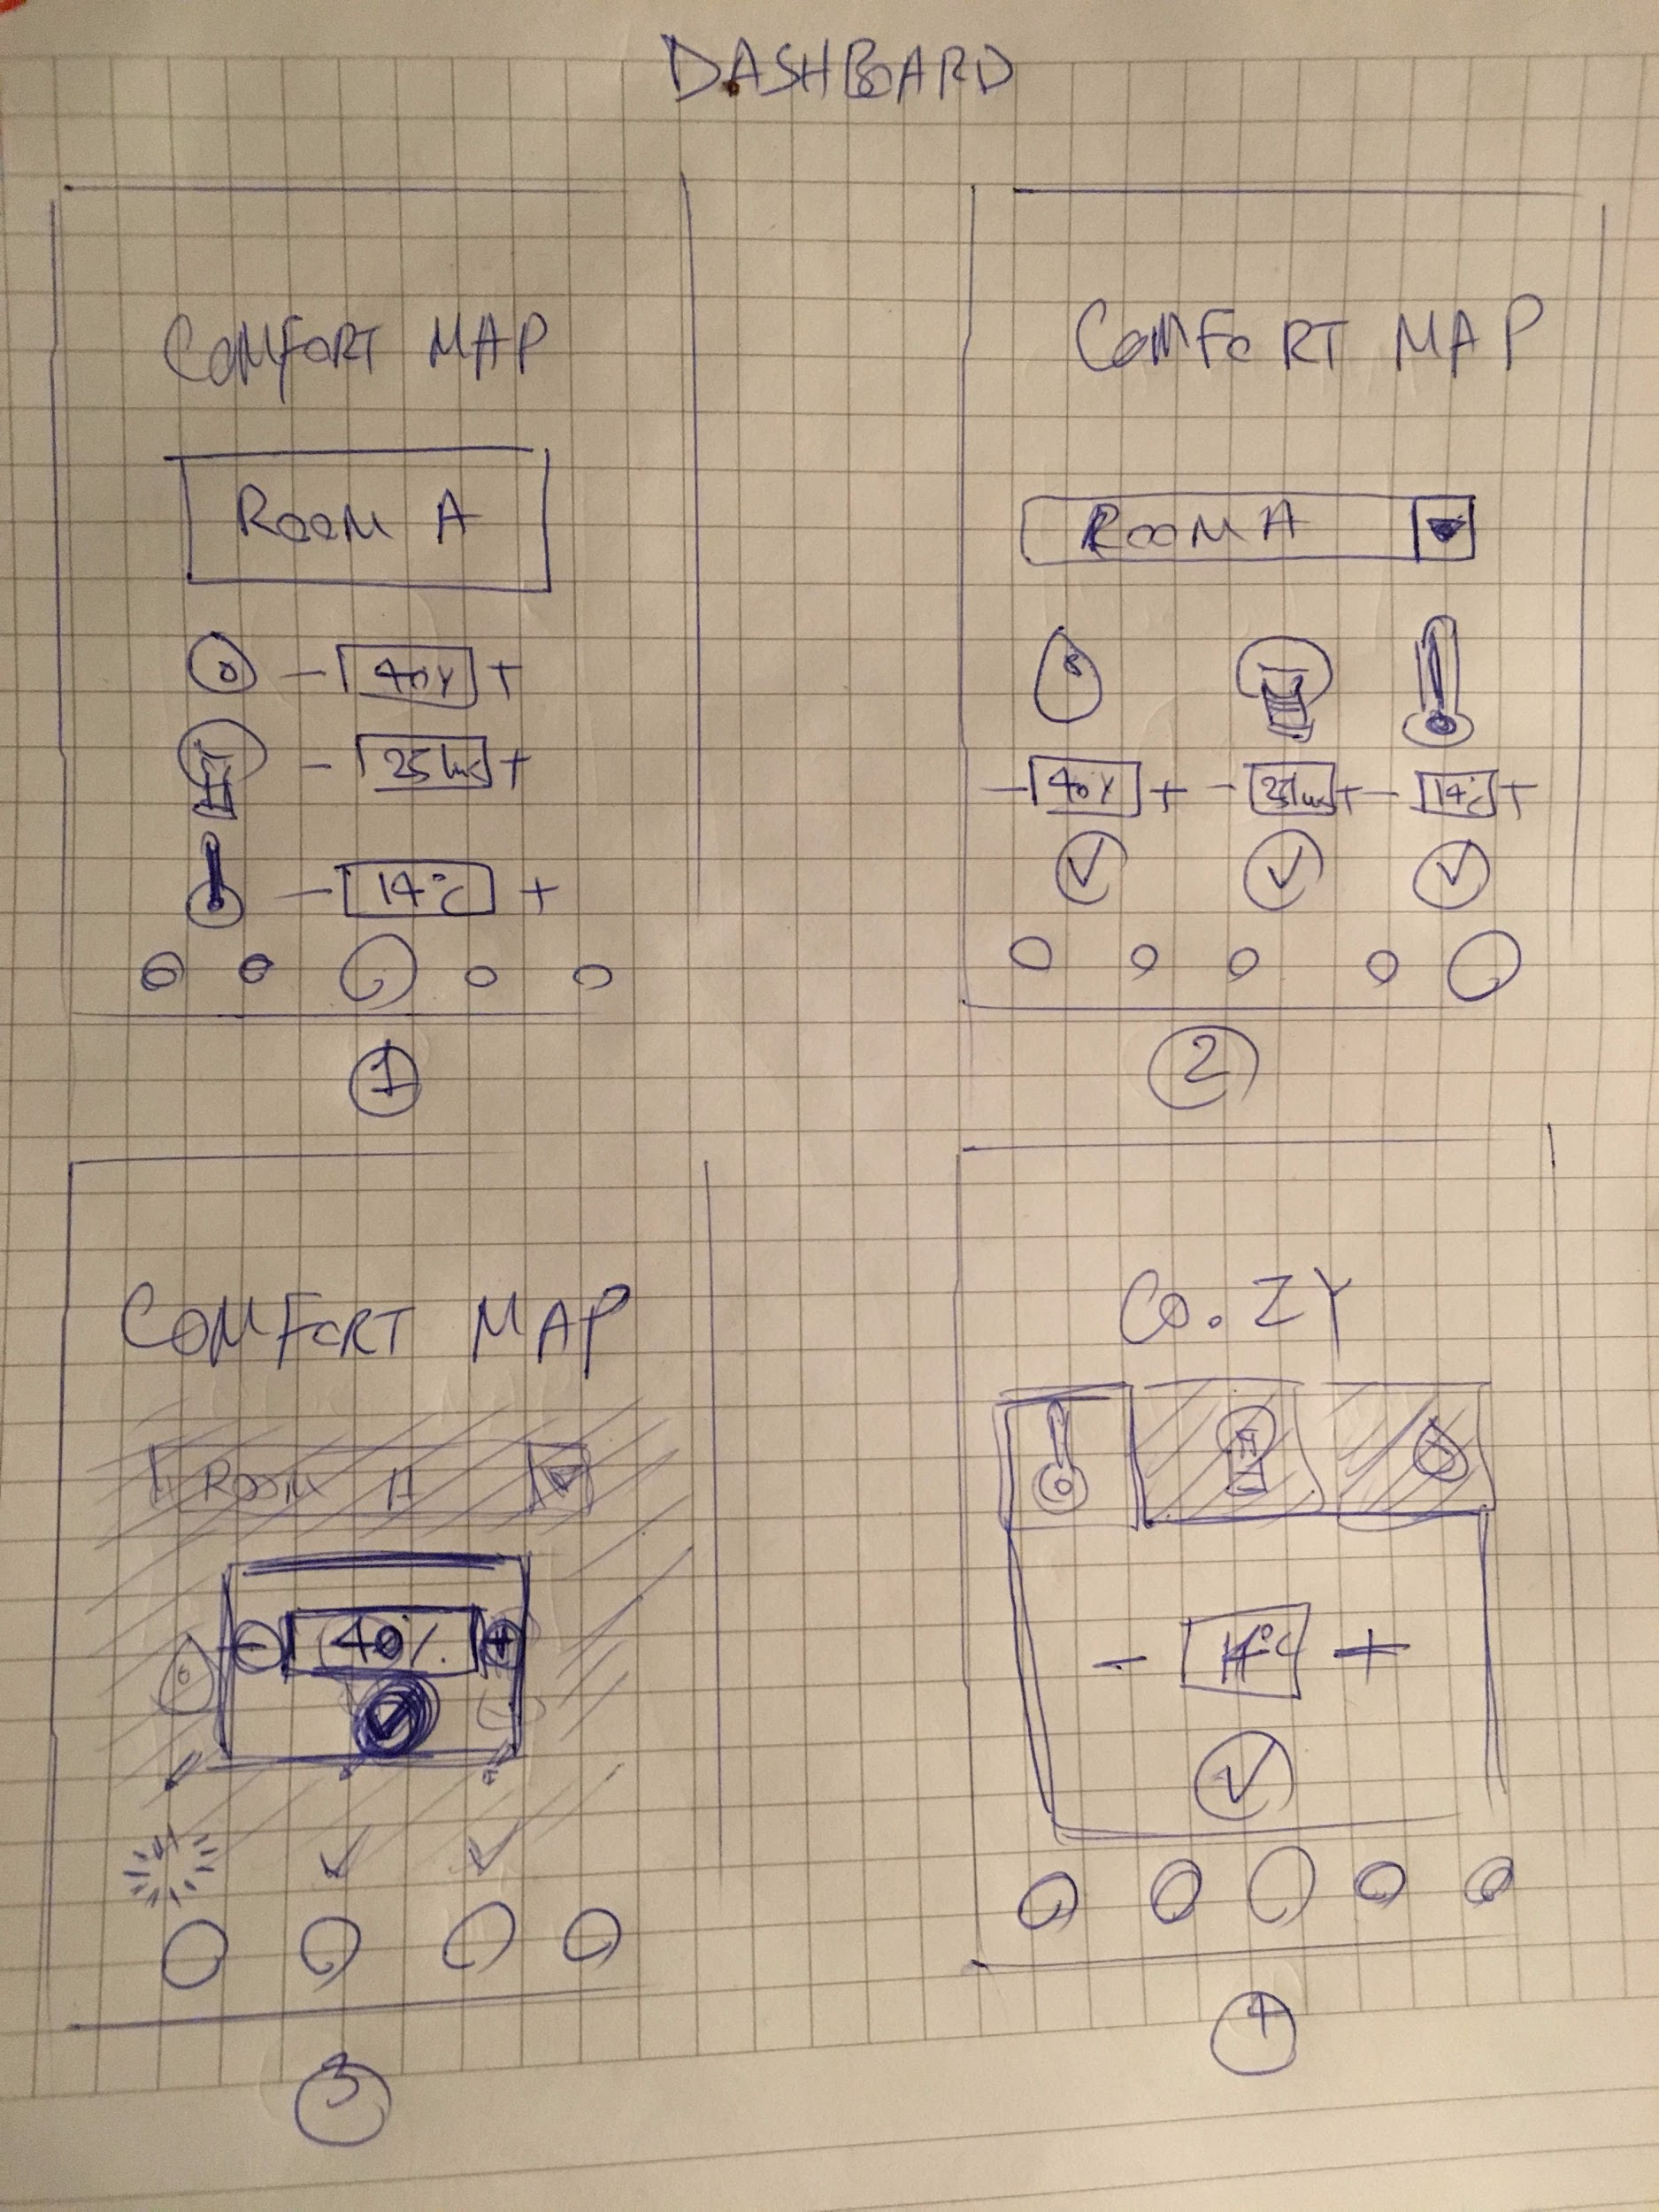
WIREFRAMES
Notes:
These are our Dashboard wireframes.
We had a tough time figuring out what to do in order to display all of the information without it being too crowded with text.
We also had problems choosing icons and deciding what would be the best UI for a user to use. Since we wanted to go for a simpler UI, we decided to split up the 3 modules into tabs, so that it’s easier to adjust, while keeping the page consistent for familiarity.

Slide 13
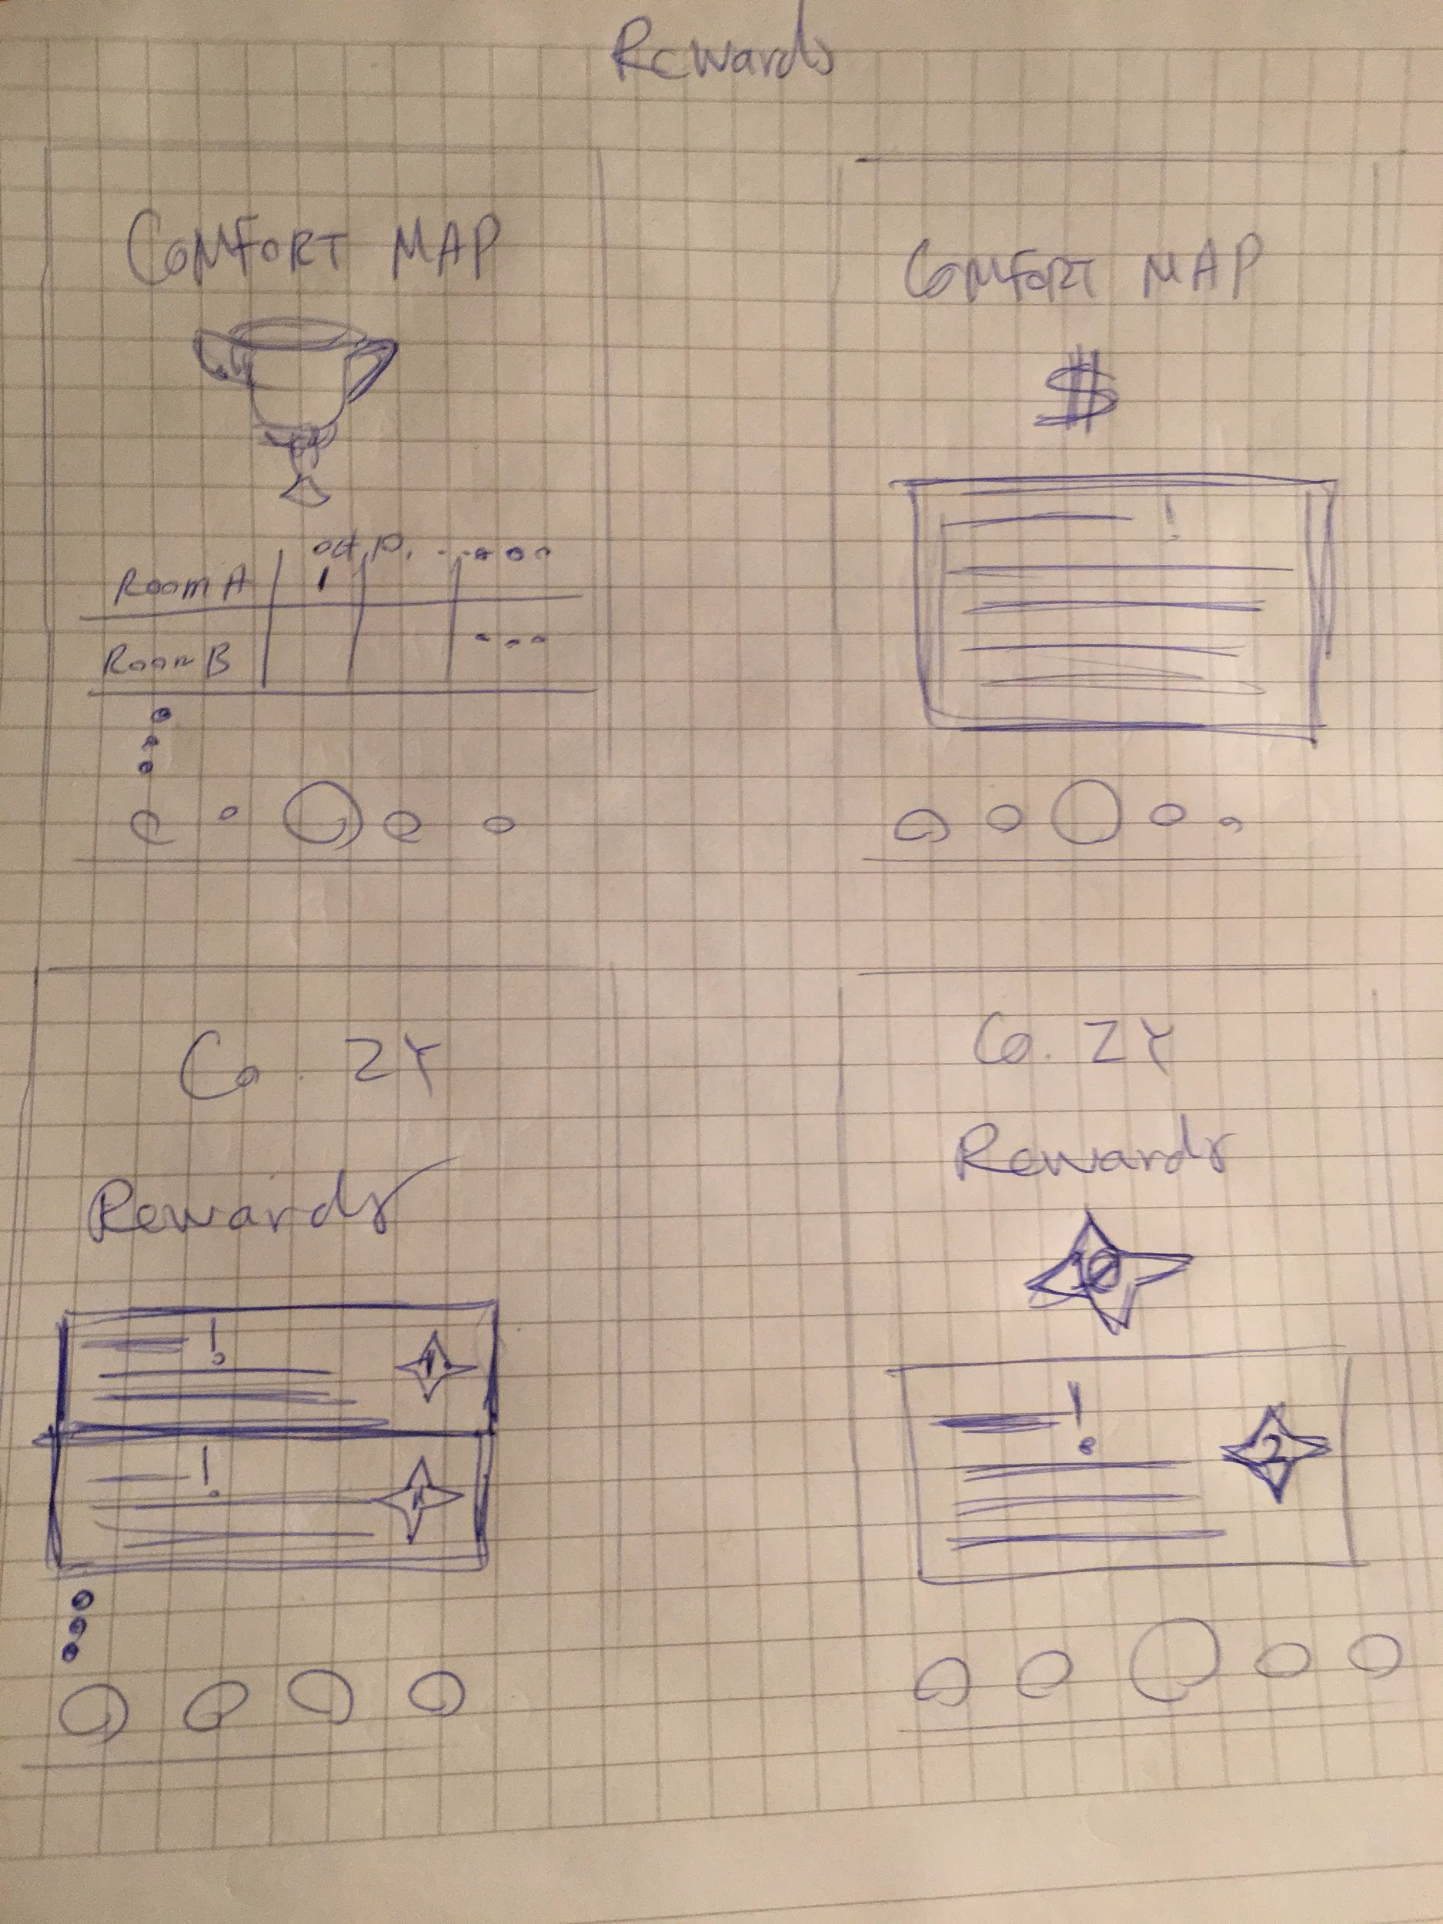
WIREFRAMES
Notes:
These are our wireframes for the Rewards section.
A big problem that we encountered was that users didn’t understand what the Stars they were collecting were for and what the rewards actually are. Users were confused about why they even needed this section and what it was for. We needed a way to show them the rewards without having too much text.
The purpose of the system was intended to show users how much money they were saving to be more eco-friendly by saving power. Stars and a rewards system was designed to motivate users to keep saving energy.

Slide 14
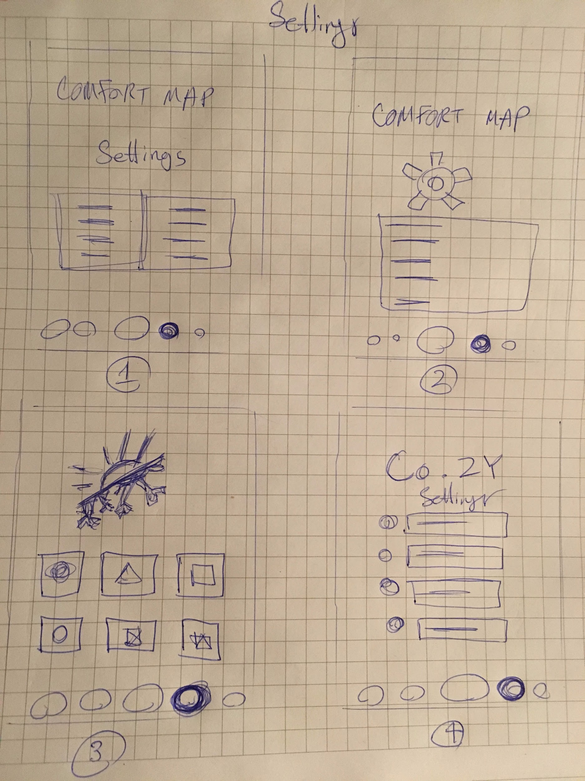
WIREFRAMES
Notes:
These are wireframes for the Settings pages.
A lot of confusion came to what the Settings icon should look like and what kind of information it would have in it.
We made the icon one of the more universally recognizable cog wheel icon, to avoid some confusion.
The other issue we had was how to present this information, since it was a long list and could present problems for people who were not native English speakers. To resolve this, we concluded that we would also place icons beside each link to help identify the context of those links.

Slide 15
USER TESTING
Goals, Tasks, Questions
Results & Conclusion
User was confused by what do we mean by comfort ‘map’ (originally named our app ‘Comfort Map’)
Unclear on dashboard icons and what they mean.
Unclear on what Rewards meant and why they needed to earn Stars.
They could not change humidity (the water drop is ambiguous).
App purpose and messages were clear.
User was unclear if app icons were interactive/clickable
Several changes made to app wireframes
Notes:
Through user testing, the user needed to browse and navigate through the prototype without prior knowledge of what the app is and what it is supposed to do.
The goals with user testing was to understand the level of understanding of the user regarding the app: the technical keywords used, app interactions and the flow.
Tasks included:
Open the application
Navigate to different section
Change settings
Understand displayed information
Change set - points
Update personal information
Questions we asked the user:
Can you tell what this app does?
Did you expect to see each page as you were navigating to them?
Are you able to identify what you are required to do to change setpoints?
Where do the signs in the dashboard mean? can you read them and their values?
Are you able to change those values?
Do you understand the meaning of the messages that are displayed below?
What is the purpose of this app?
What do you think you will find frustrating while using it?
Results & Conclusion
User was confused by what do we mean by comfort ‘map’ (originally named our app ‘Comfort Map’), they were looking for a map; otherwise they were comfortable with each screen.
Unclear on dashboard icons and what they mean.
Unclear on what Rewards meant and why they needed to earn Stars.
They could not change humidity (the water drop is ambiguous).
App purpose and messages were clear.
User was unclear if app icons were interactive/clickable. May need another indication or tutorial.
Through these problems we encountered, we made several changes to the app wireframes and worked towards our final prototype.

Slide 16
PERSONA: SARA JOHNSON
55yo, educated, has grandchildren
Friendly, patient
Use social media apps
Works at the office and in-house building management
Wants to save money and increase productivity
Frustrated​ ​by​ ​frequent​ ​and​ ​repeated complaints​ ​by​ ​the​ ​same​ ​clients​ ​for​ ​the same​ ​issues
Motivated​ ​to​ ​reduce​ ​cost​ ​of​ ​maintenance and​ ​power
Cares about employee satisfactions and communication
DITL
Notes:
Today, we will be walking through the app as Sara Johnson:
Sara is 55 years, educated, has grandchildren. Friendly, patient, uses social media moderately. You’re like a hybrid between an employee and a building manager, so you work at the office and also is in charge of in house building management.
She wants to save money and create pleasant social interactions, and always strives to find new ways to engage with tenants, make new friends in the building, and improved communication with employees. Her main goal is to maintain employee satisfaction and while increasing worker productivity and minimizing errors.
Frustrated​ ​by​ ​frequent​ ​and​ ​repeated complaints​ ​by​ ​the​ ​same​ ​clients​ ​for​ ​the same​ ​issues, and knows that regularly​ ​interacting​ ​with​ ​the​ ​app​ ​slightly​ ​lowers​ ​productivity​ ​for​ ​each employee
She understands that both​ ​office​ ​workers​ ​and​ ​building​ ​managers​ ​are​ ​under​ ​considerable​ ​time stress,​ ​any​ ​additional​ ​tasks​ ​must​ ​save​ ​them​ ​either​ ​time​ ​or​ ​money​ ​in​ ​the​ ​long run
Motivated​ ​to​ ​reduce​ ​cost​ ​of​ ​maintenance and​ ​power
Basically, Sara wants new, effective ways to engage and interact with tenants while saving her money in operating the building management.
In a Day In The Life of Sara, she clocks in at 8am and checks her emails after settling in her desk around 9am. In the morning, she greets other employees in-person and greets clients over phone during calls. Near noon, she starts looks up a place online to go for lunch and grabs lunch. In the afternoon, she may receive employee complaints, and if can’t deal with the issue herself, she would call maintenance operators for help. At 6pm, she clocks out and leaves office to go home.

Slide 17
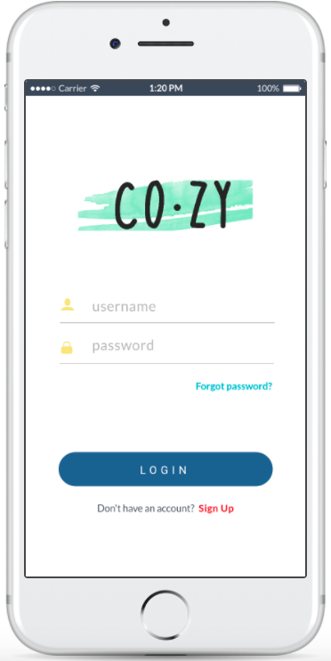
LIVE PREVIEW
Notes:
We will now take you to a Live Preview version of our app!
https://marvelapp.com/52861bd/screen/33749629

Slide 18
Thank you And STAY
Notes:
Thank you for your time! And stay cozy, everyone!

